Slide 1
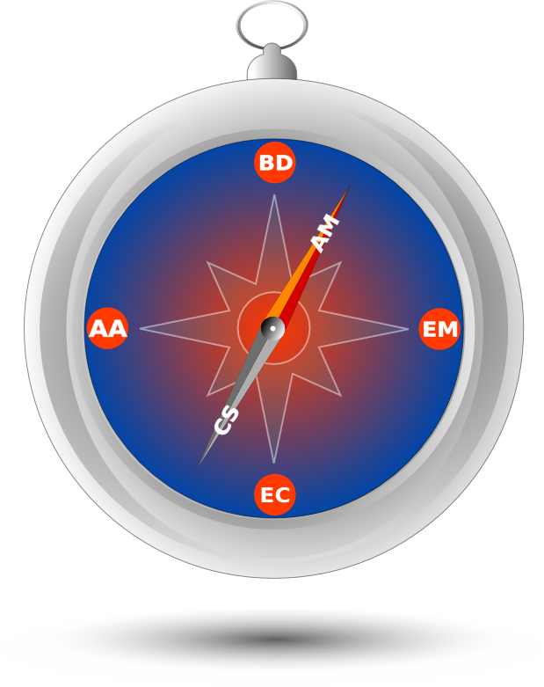
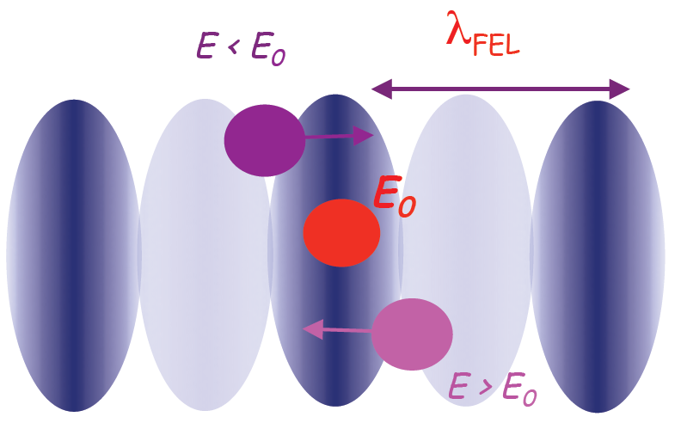
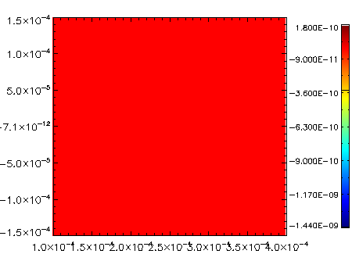
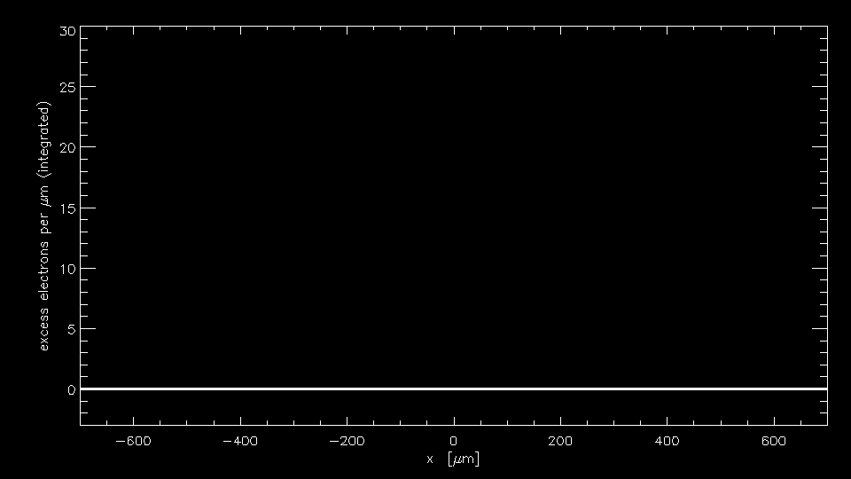
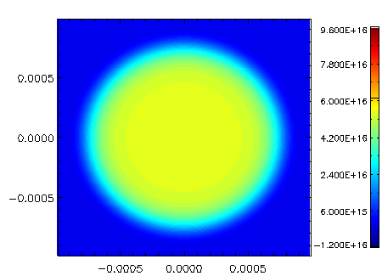
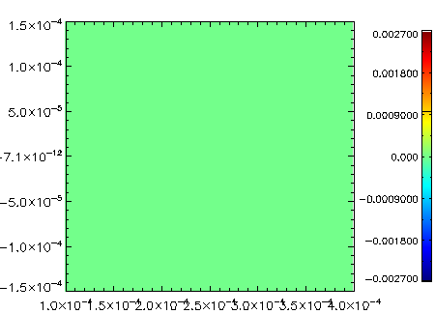
High-fidelity 3D modulator simulations of coherent electron cooling systems
Tech-X Corp: George Bell, David Bruhwiler, Brian Schwartz and Ilya Pogorelov
BNL: Vladimir Litvinenko, Gang Wang and Yue Hao
Contact email: gibell@txcorp.com (George Bell)
Schematic of the BNL Coherent Electron Cooler (Proof-of-Principle)
Modulator
High gain FEL
Kicker
RHIC ring
RHIC ring
hadrons
electrons
Beam dump
22 MeV linac
Introduction
Evolution of the density perturbation
Coherent electron cooling (CEC) is a novel technique for rapidly cooling high-energy hadron beams [1]. The proposed Brookhaven CEC consists of three sections: a modulator, where the ion imprints a density wake on the electron distribution, an FEL, where the density wake is amplified by a free-electron laser, and a kicker, where the amplified wake interacts with the ion, resulting in dynamical friction for the ion.
y=0 slice of the density perturbation
0.3mm
Simulations of Debye shielding in the modulator
We simulate Debye shielding in a realistic beam where the density varies in space. The beam also focuses down as it moves through the modulator, so the density changes in time as well. We use a simplified beam model which is radially symmetric.
To simulate the perturbation to the electron density due to the ion, we use delta-f PIC in the Tech-X code Vorpal.
Beam focusing in the Modulator
0.3mm
Evolution of Ex
2 mm
0.3mm
Conclusion
The constant density theory of Wang and Blaskiewicz [2] predicts shielding wakes well when the ion is in a constant density region, even when it changes in time.
References:
[1] Litvinenko & Derbenev, “Coherent Electron Cooling,” Phys. Rev. Lett. 102, 114801 (2009). [2] Wang and Blaskiewicz, Phys Rev E 78, 026413 (2008).
2 mm
0.3mm

