Slide 1
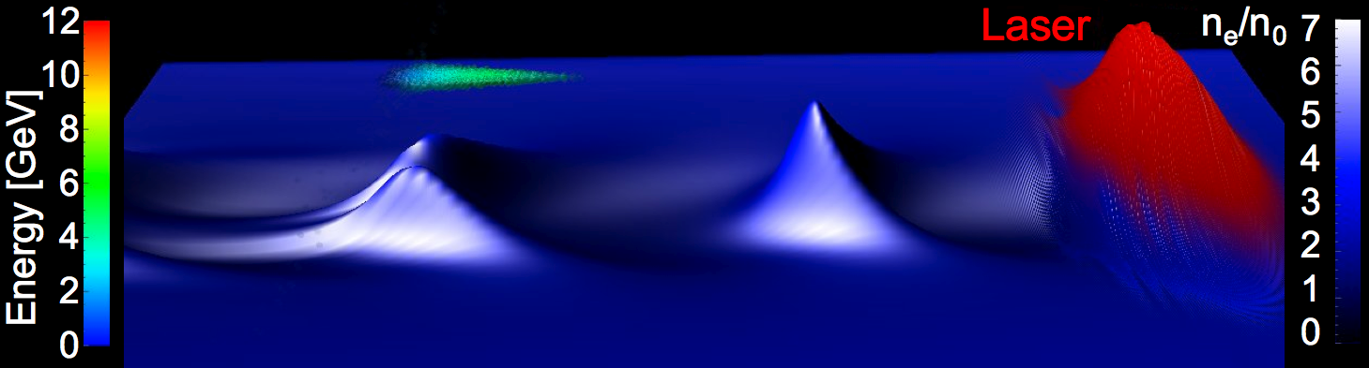
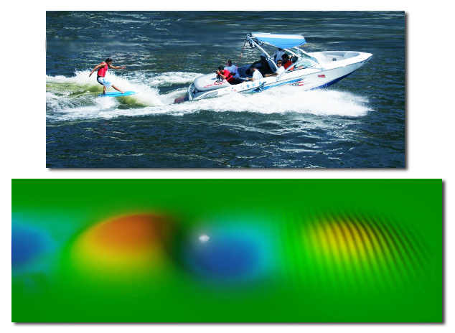
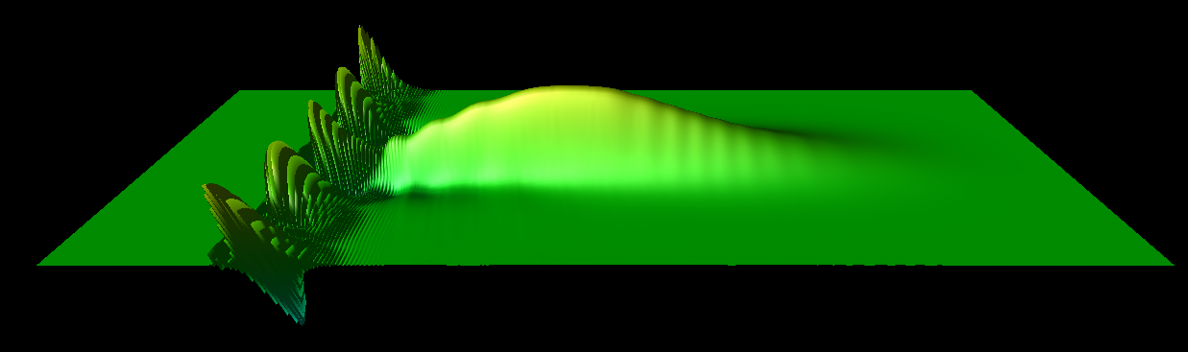
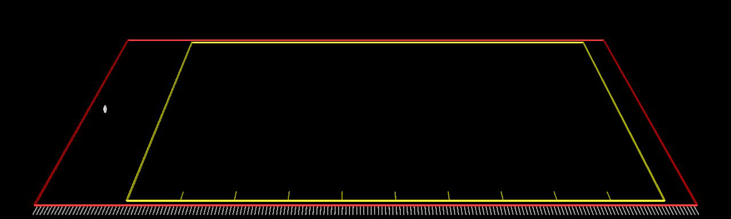
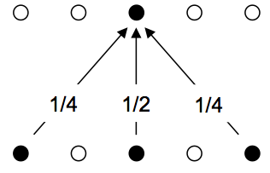
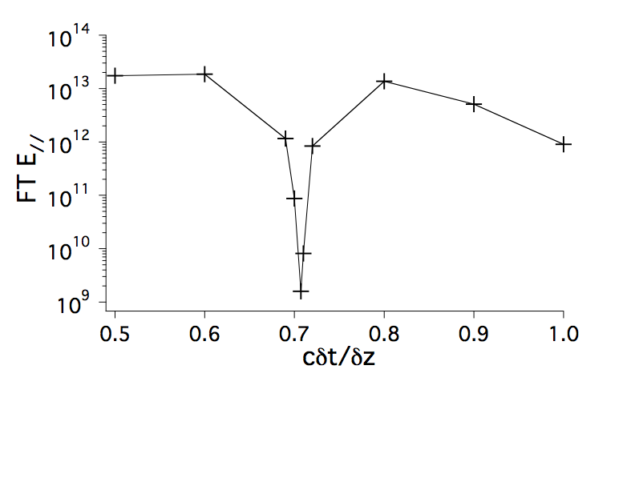
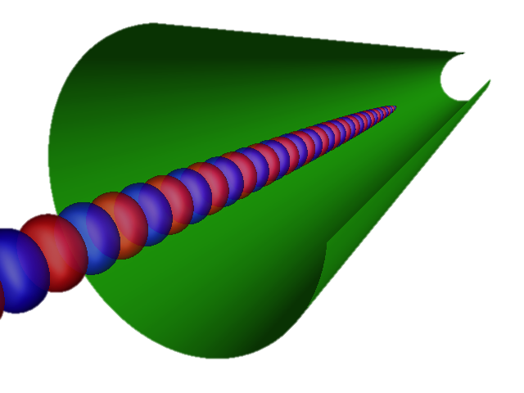
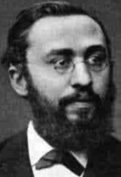
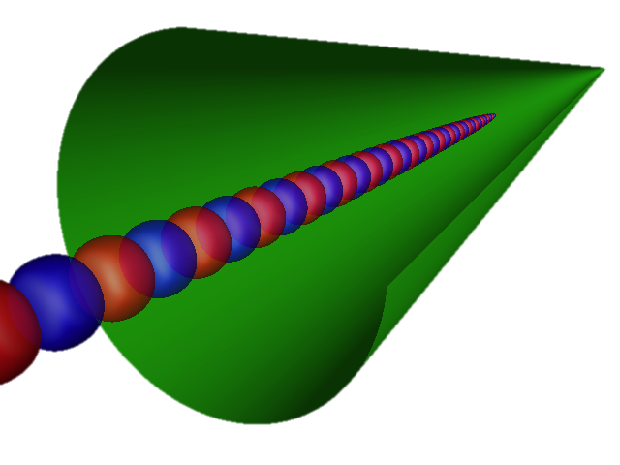
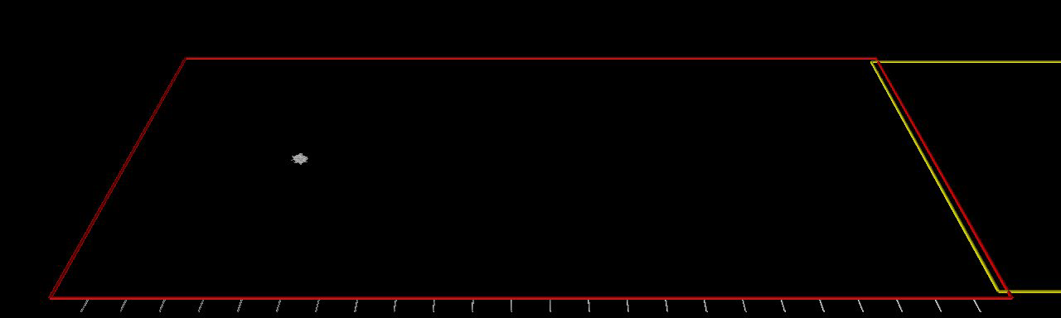
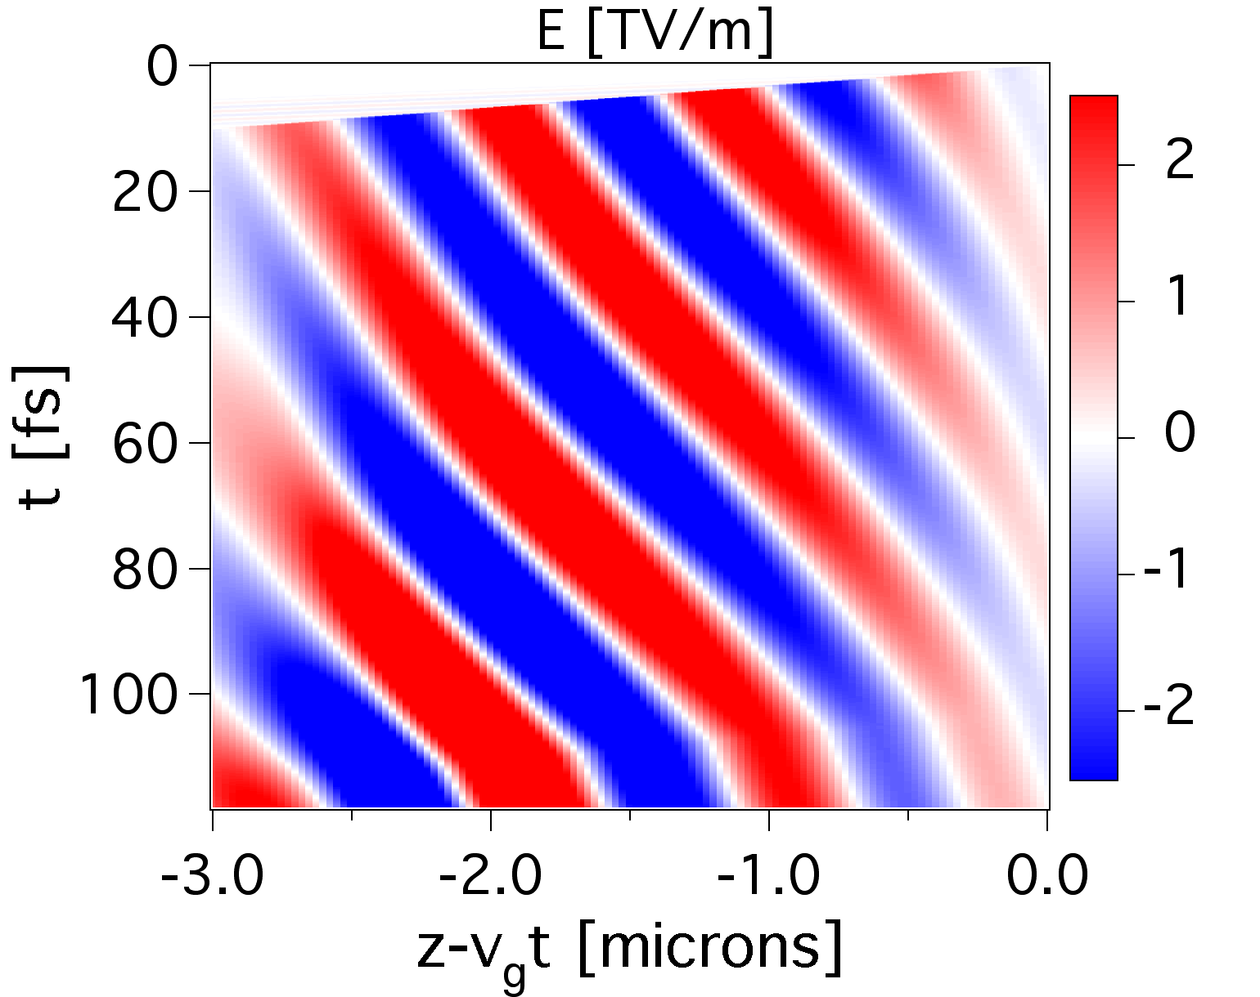
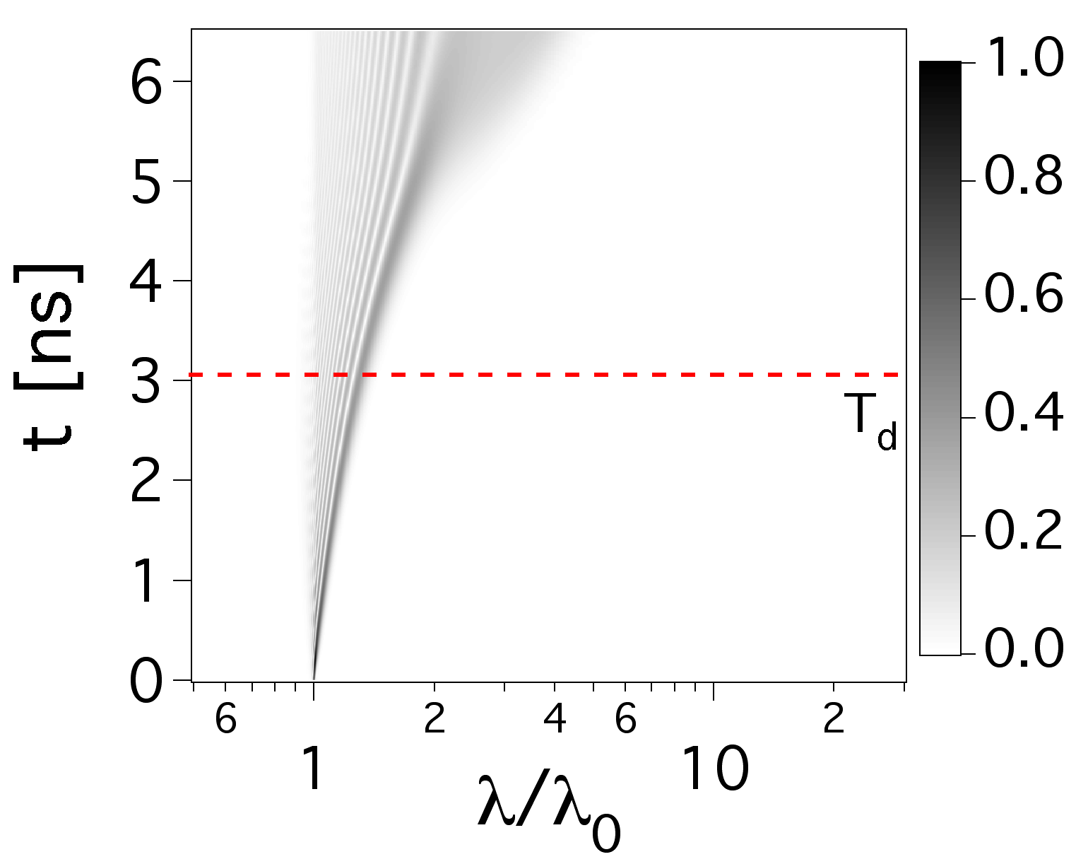
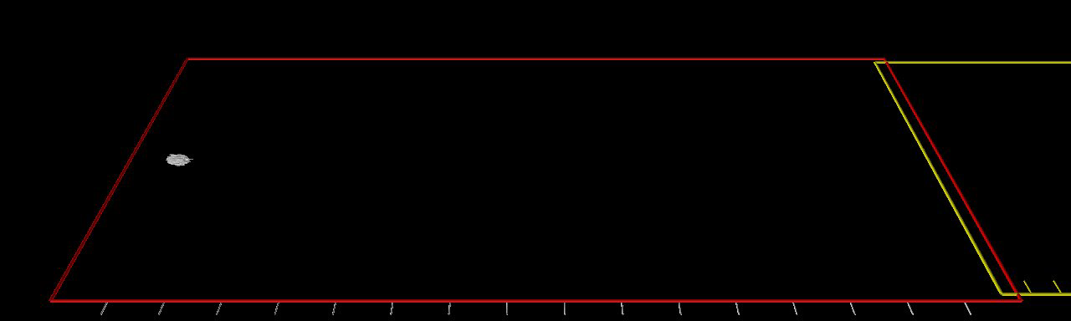
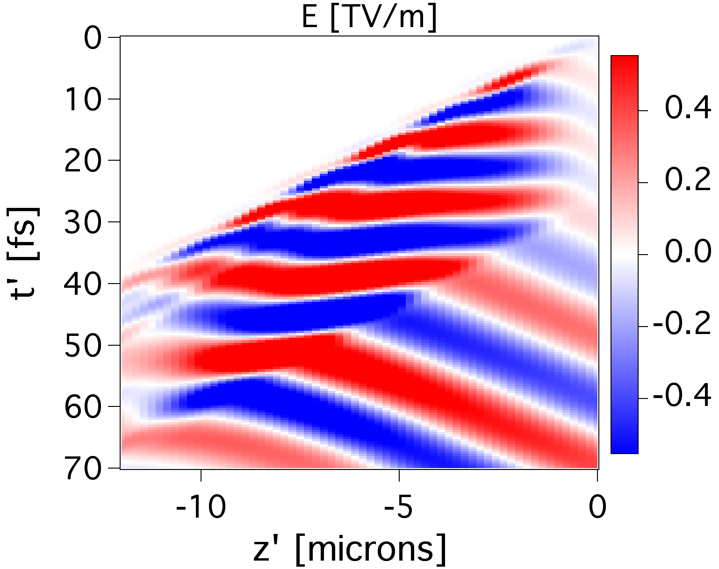
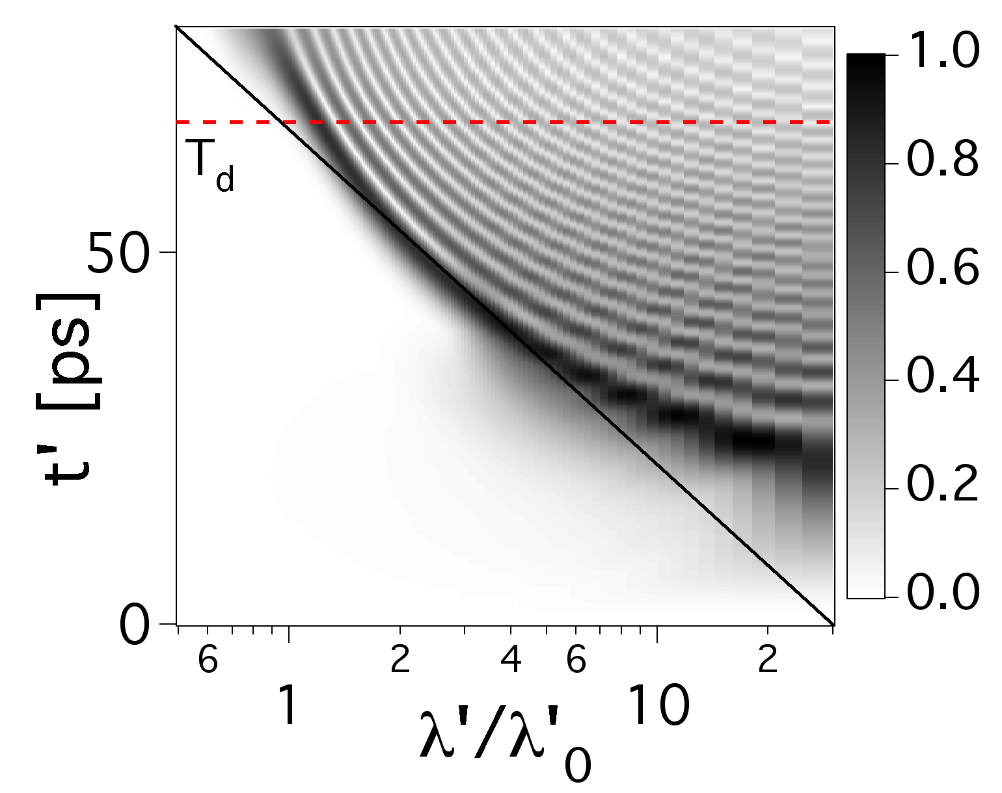
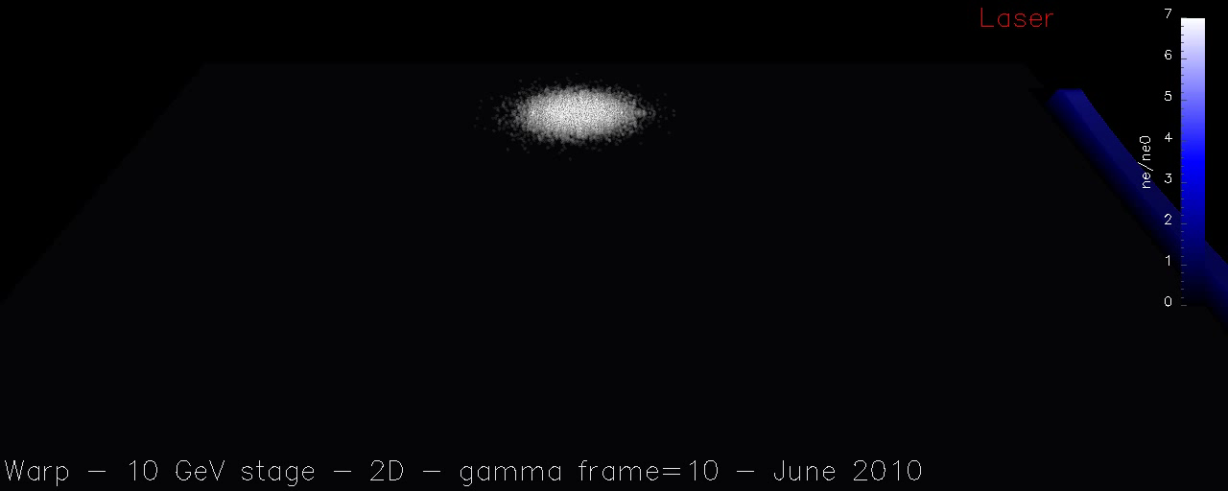





Modeling of 10 GeV-1 TeV Laser-Plasma Accelerators using Lorentz Boosted Frame Simulations
J.-L. Vay, C. Geddes, E. Esarey, W. Leemans, C. Schroeder (LBNL, CA, USA), D Grote (LLNL, CA, USA), E. Cormier-Michel (Tech-X, CO, USA)
Laser-Plasma Acceleration (LPA)
Speedup Limitations have been Overcome
Full Scale Simulations of 0.1 GeV – 1 TeV Stages
A strong instability has been observed in boosted frame PIC simulations for large γ.
Novel numerical techiques (tunable elecromagnetic solver, “strided” digital filter), and a time step at which the instability growth is greatly reduced, enable efficient mitigation of the instability.
The boosted frame method has been benchmarked carefully on a 0.1 GeV LPA stage. Agreement has been obtained at the % level between simulations at various γ.
2D
Longitudinal electric field
3D
laser
Exact
Yee
Cole-Karkkainen
plasma
Warp 2-1/2D 10 GeV LPA (n_{e}=10¹⁷cc, γ=130)
In the boosted frame, the Rayleigh length of the laser is contracted by γ, while its transverse size increases as γ², preventing the initialization of the entire laser at once.
A novel method launching the laser from a moving planar antenna was developed.
Like a speedboat leaving a wake that a surfer can ride, a laser pulse in a laser-plasma wakefield accelerator creates a wake in the plasma that an electron beam “surfs” to high energy.
EM solver with tunable numerical dispersion
Lorentz Boosted Frame Method
Instability level
Lab frame
Boosted frame γ = 100
“Strided” digital filtering
Time step
Special time step
J.-L. Vay, et al, PoP 18 123103 (2011)
J.-L. Vay, et al., J. Comput. Phys. 230 (2011)
Hyperbolic rotation from Lorentz Transformation converts laser spatial oscillations into time beating,
==> enabling high levels of digital filtering without altering the physics.
Boosted frame method enables modeling of fully depleted 10 GeV-1 TeV stages.
Hendrik Lorentz
Lab frame
Laser field
Energy
L=0.8 m
Emittance
L’=8 mm
Time
l=0.8 μm
l’=0.16 mm
X_{r.m.s.}
0.8 m/0.8 μm=1,000,000.
compaction
X20,000.
8 mm/0.16 mm=50.
Wake frame
Laser field
In the laboratory frame, millions of time steps are necessary to simulate from first principles a λ=0.8 μm laser through a 0.8 m plasma column. In a Lorentz boosted frame, the plasma column is contracted by γ, the laser expands by ~2γ, and the number of time steps is divided by 2γ².
J.-L. Vay, Phys. Rev. Lett. 98, 130405 (2007)
Time
Warp – 2-1/2D – 10 GeV stage – γ_{boost}=10
J.-L. Vay, et al., PoP Lett. 18 030701 (2011)
J.-L. Vay, C. Geddes, E. Esarey, W. Leemans, C. Schroeder, D. Grote, E. Cormier-Michel PoP 18 123103 (2011)
SciDAC-II
Compass
Office of Science

